Slide 1
AirBnB Listing Bangkok Data Analysis
Capstone Project – Sean Kristian Anderson

Slide 2
Project Outline
01
02
03
04
Data Preparation
Data Understanding
Data Cleaning
Data Segmentation
Data Analysis
Conclusion and Recommendation
05
06

Slide 3
01
Data Preparation

Slide 4
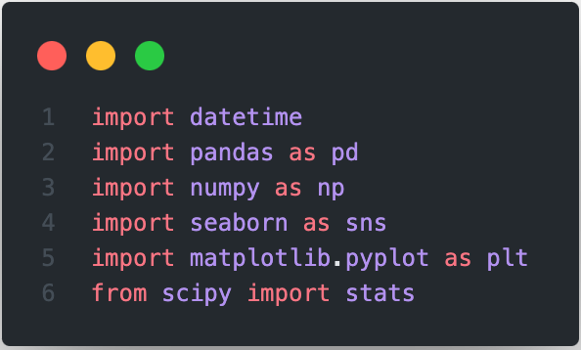
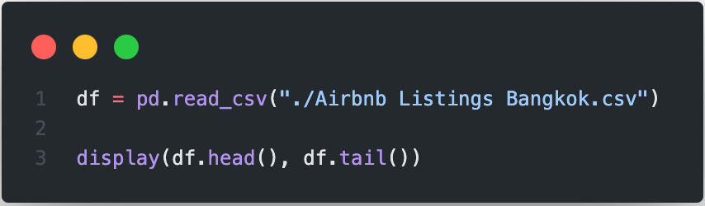

Slide 5
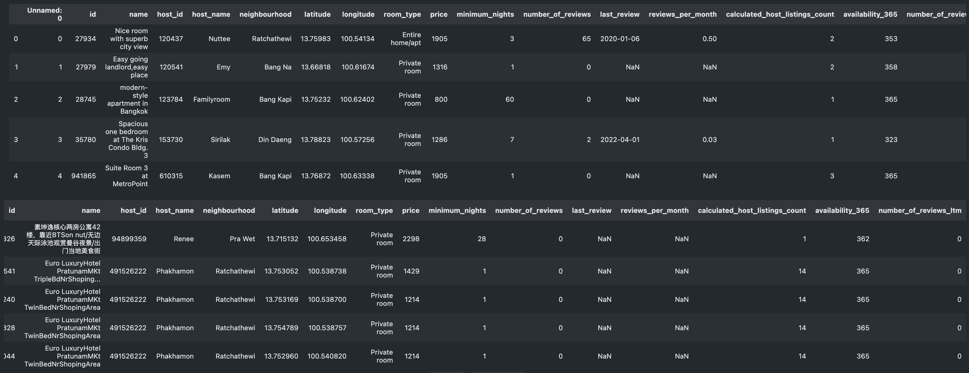

Slide 6
02
Data Understanding

Slide 7
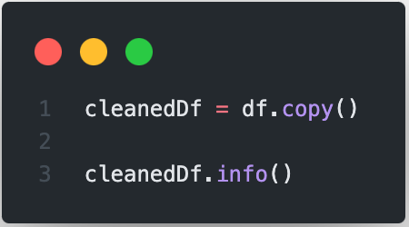
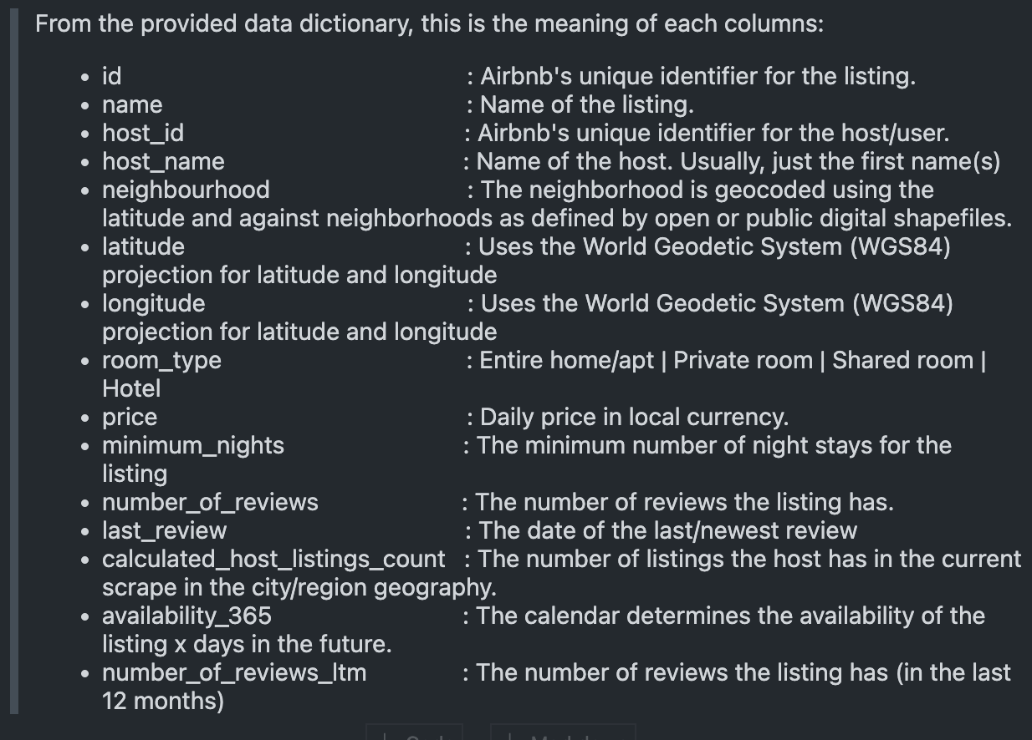
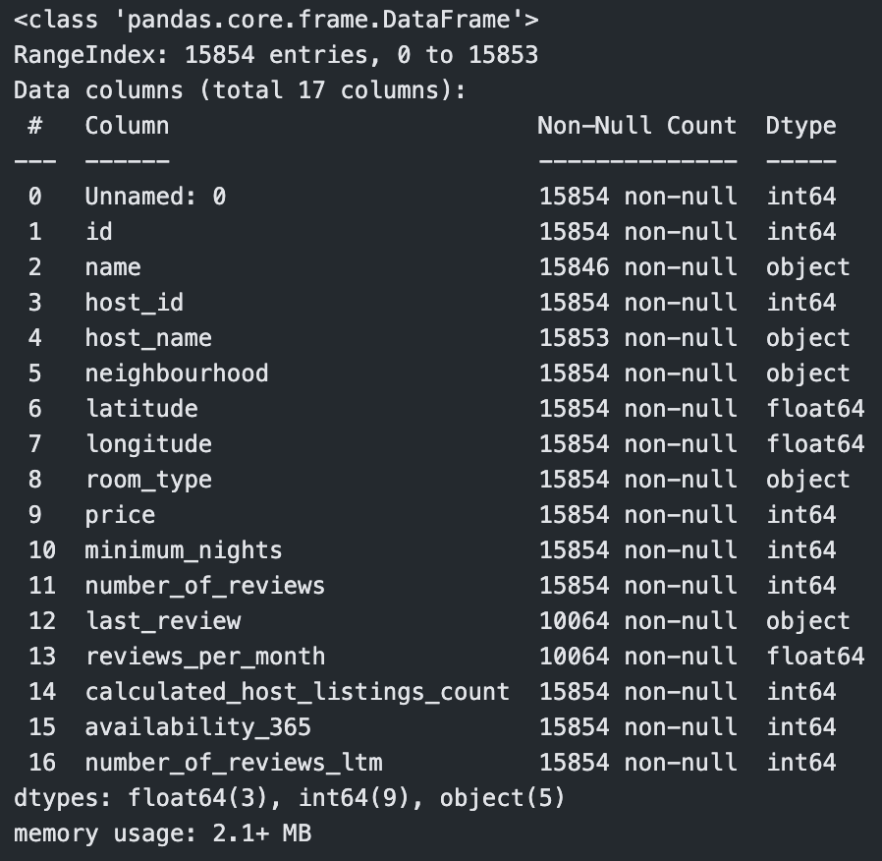
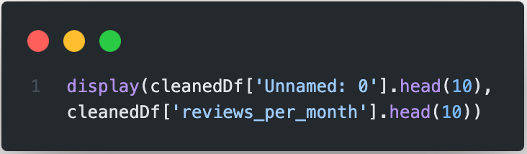

Slide 8
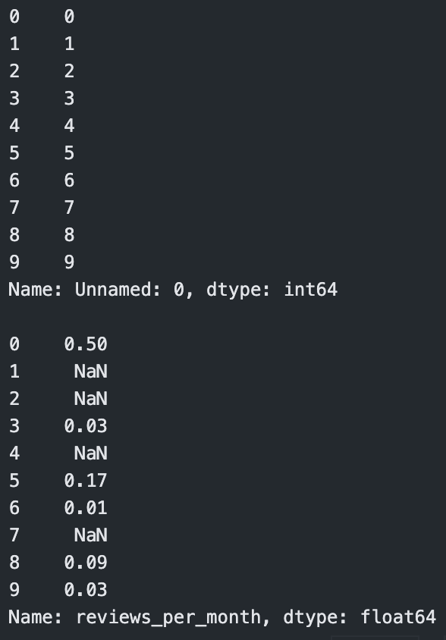
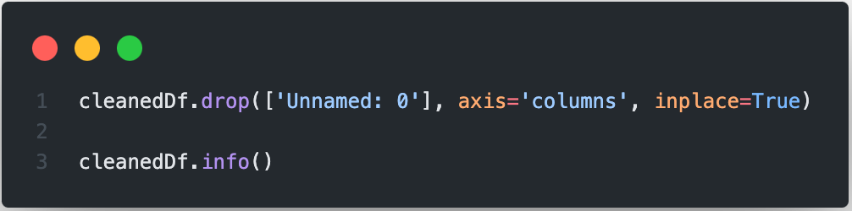
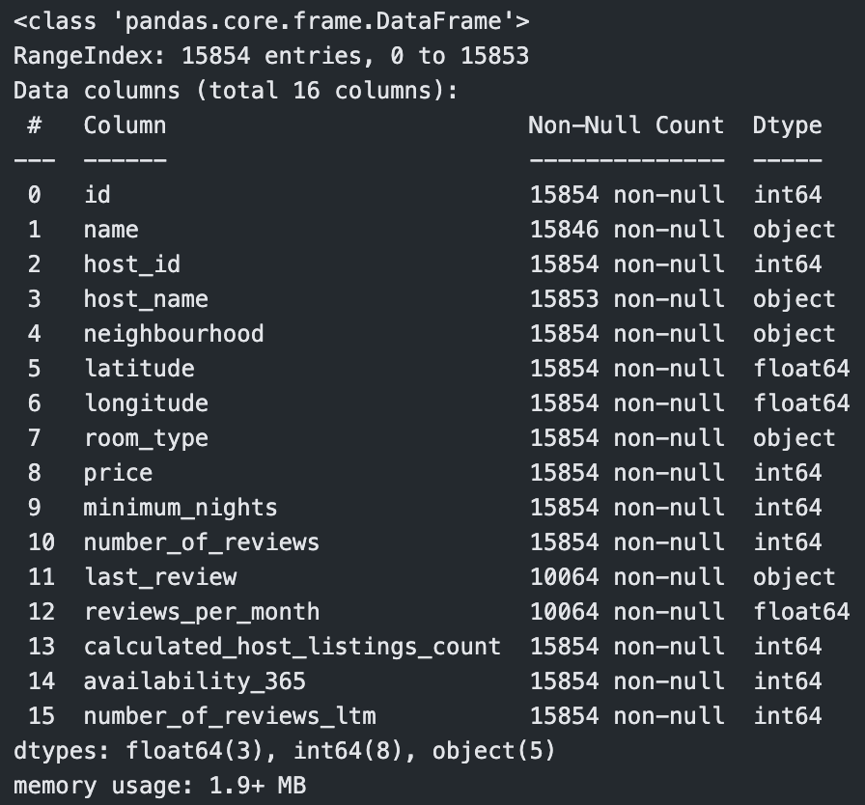

Slide 9
03
Data Cleaning

Slide 10
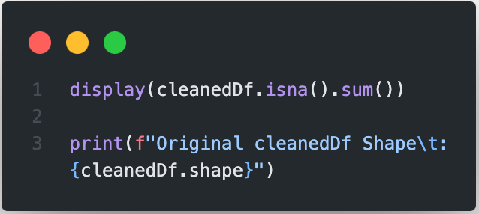
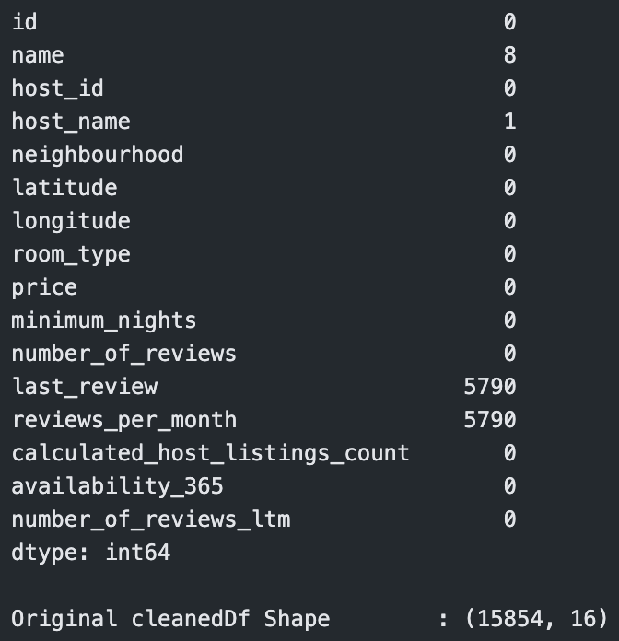

Slide 11
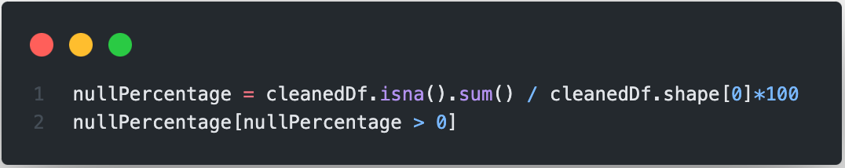
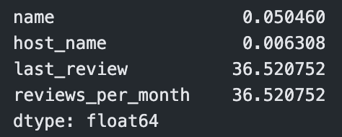

Slide 12
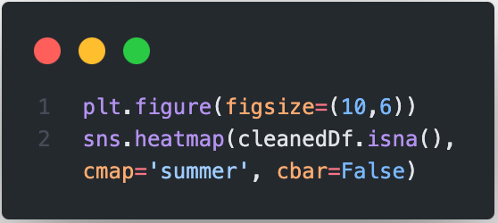
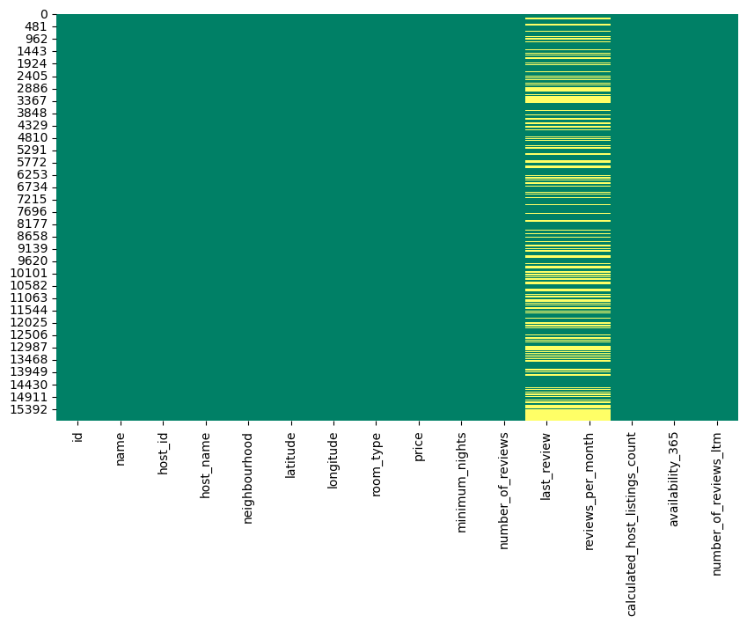
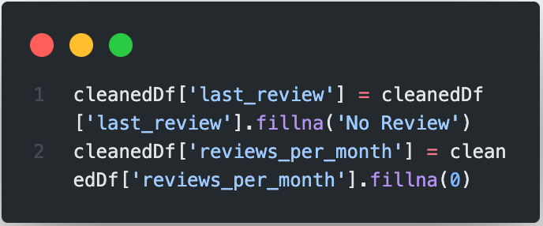
Last Review and Reviews Per Month type is MAR (Missing at Random)

Slide 13
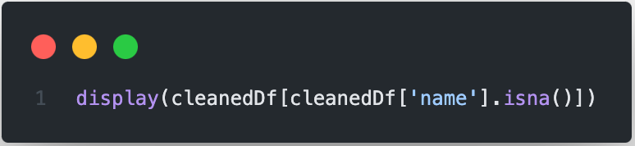
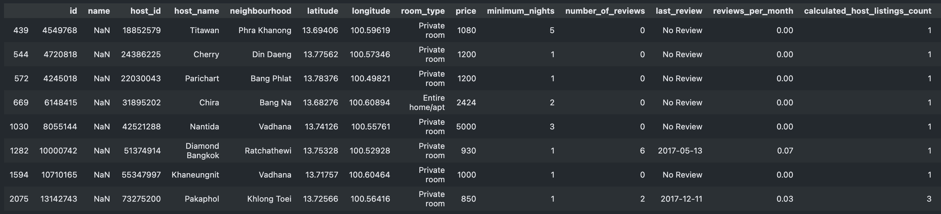
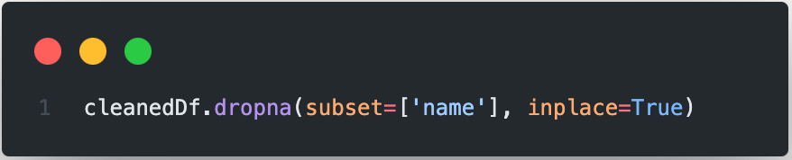
Name type is MCAR (Missing Completely at Random) since no logical or visible connection and the null percentage is negligible

Slide 14
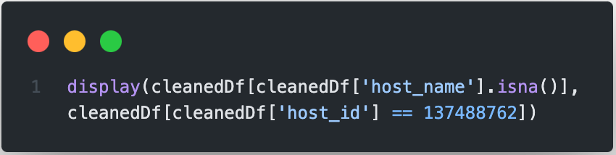
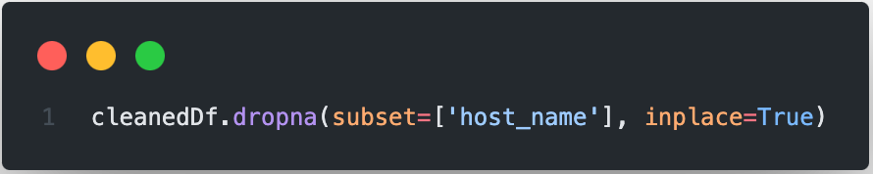
Host Name type is MAR (Missing at Random) because for each host name has unique host id

Slide 15
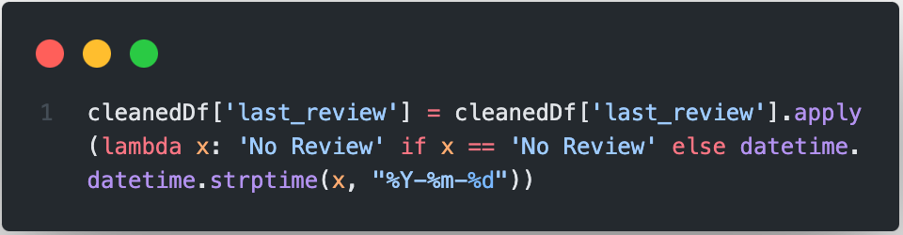
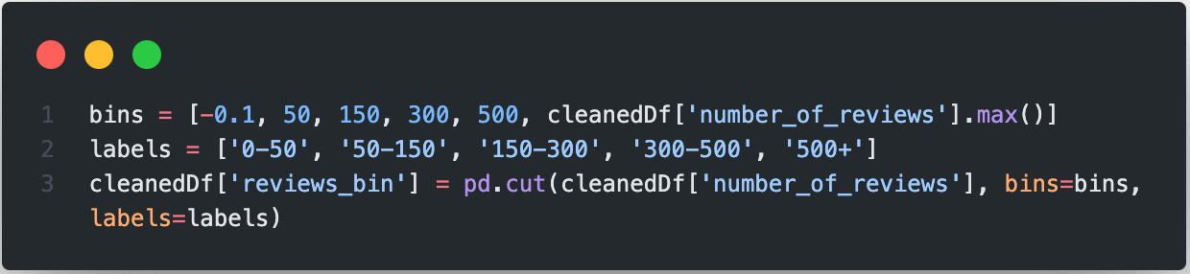

Slide 17
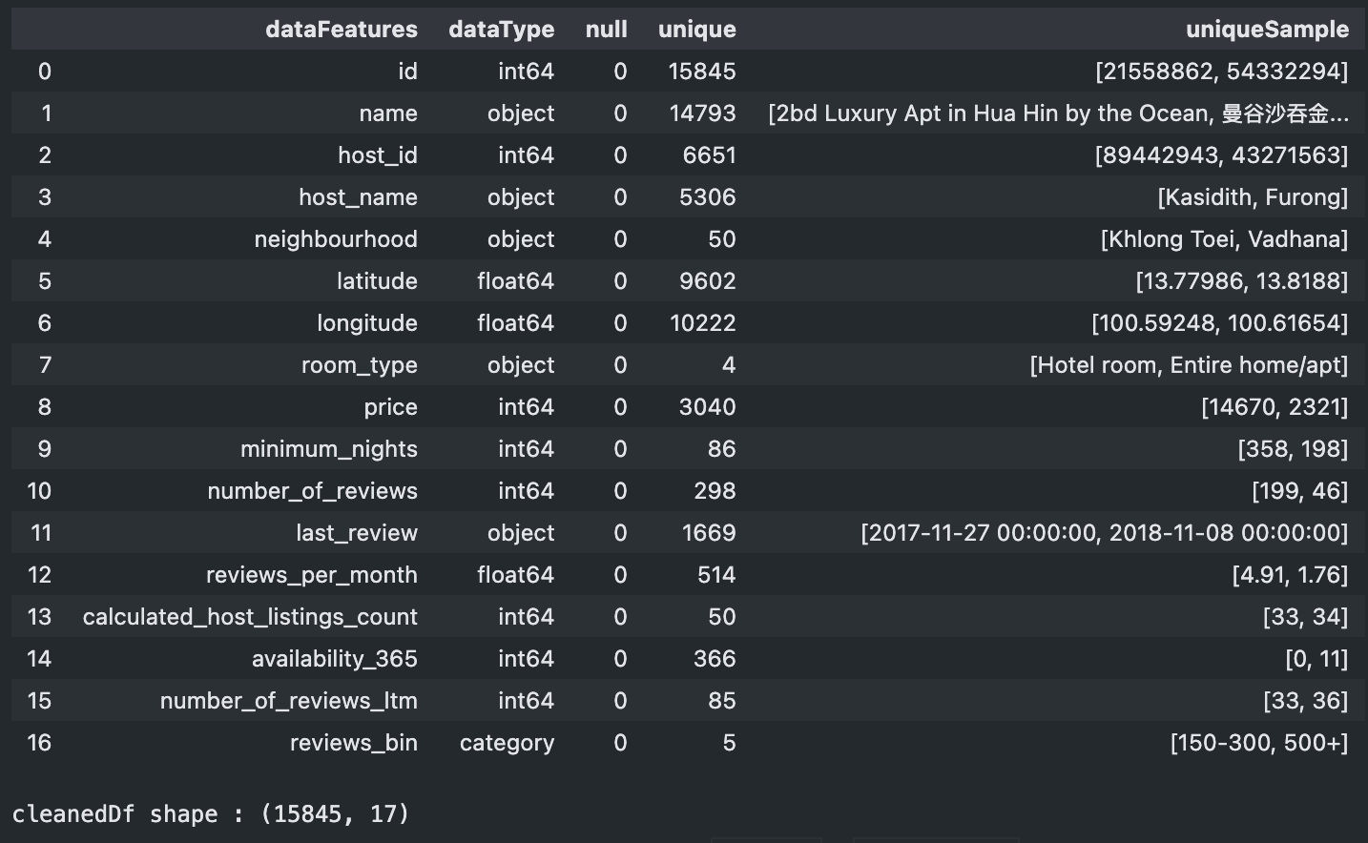
Original cleanedDfShape : (15.854, 17)
Cleaned cleanedDfShape: (15.845, 17)

Slide 18
Original cleanedDfShape : (15.854, 17)
Cleaned cleanedDfShape: (15.845, 17)

Slide 19
04
Data Segmentation

Slide 20
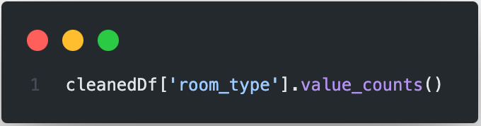
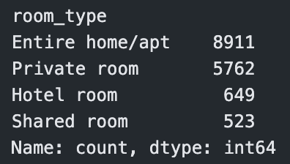
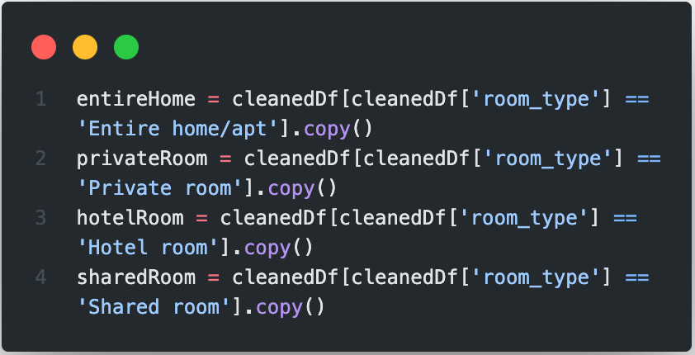

Slide 21
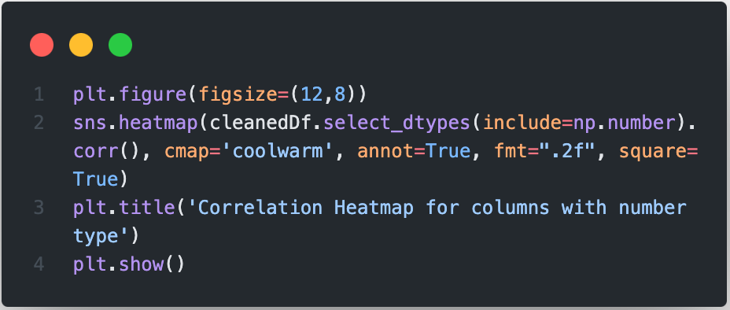
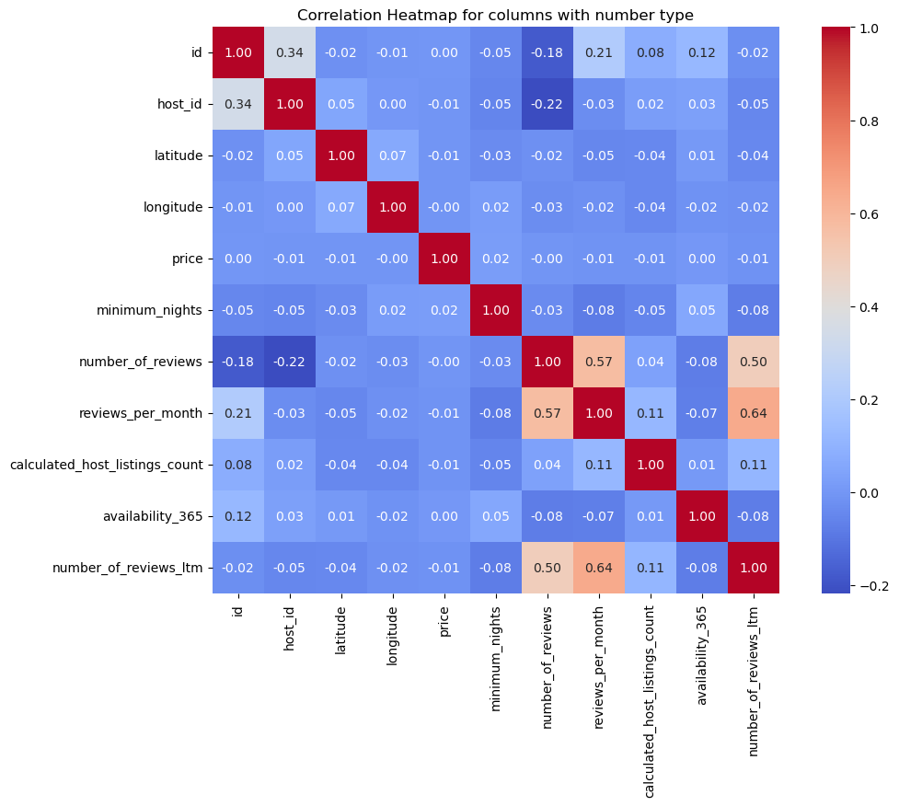

Slide 22
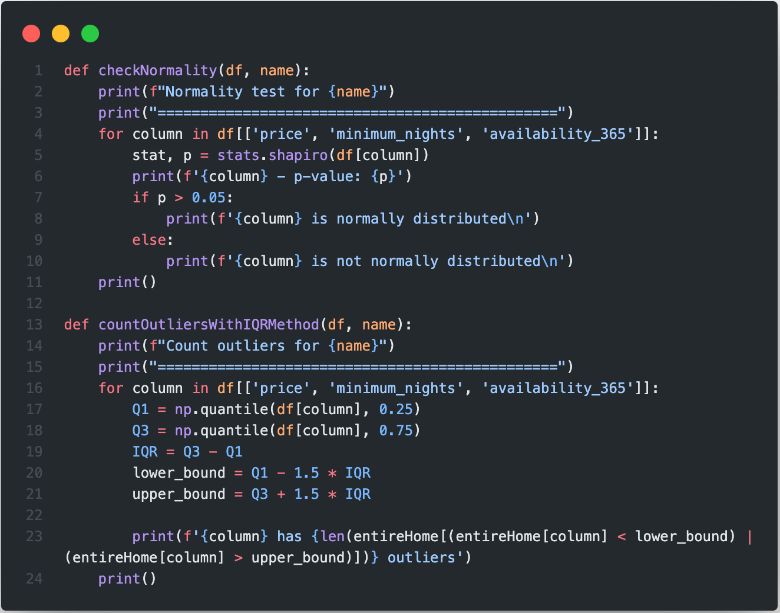

Slide 23
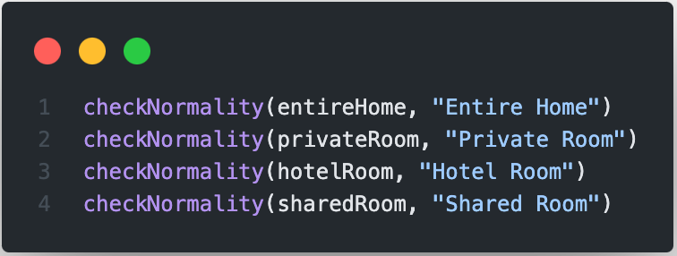
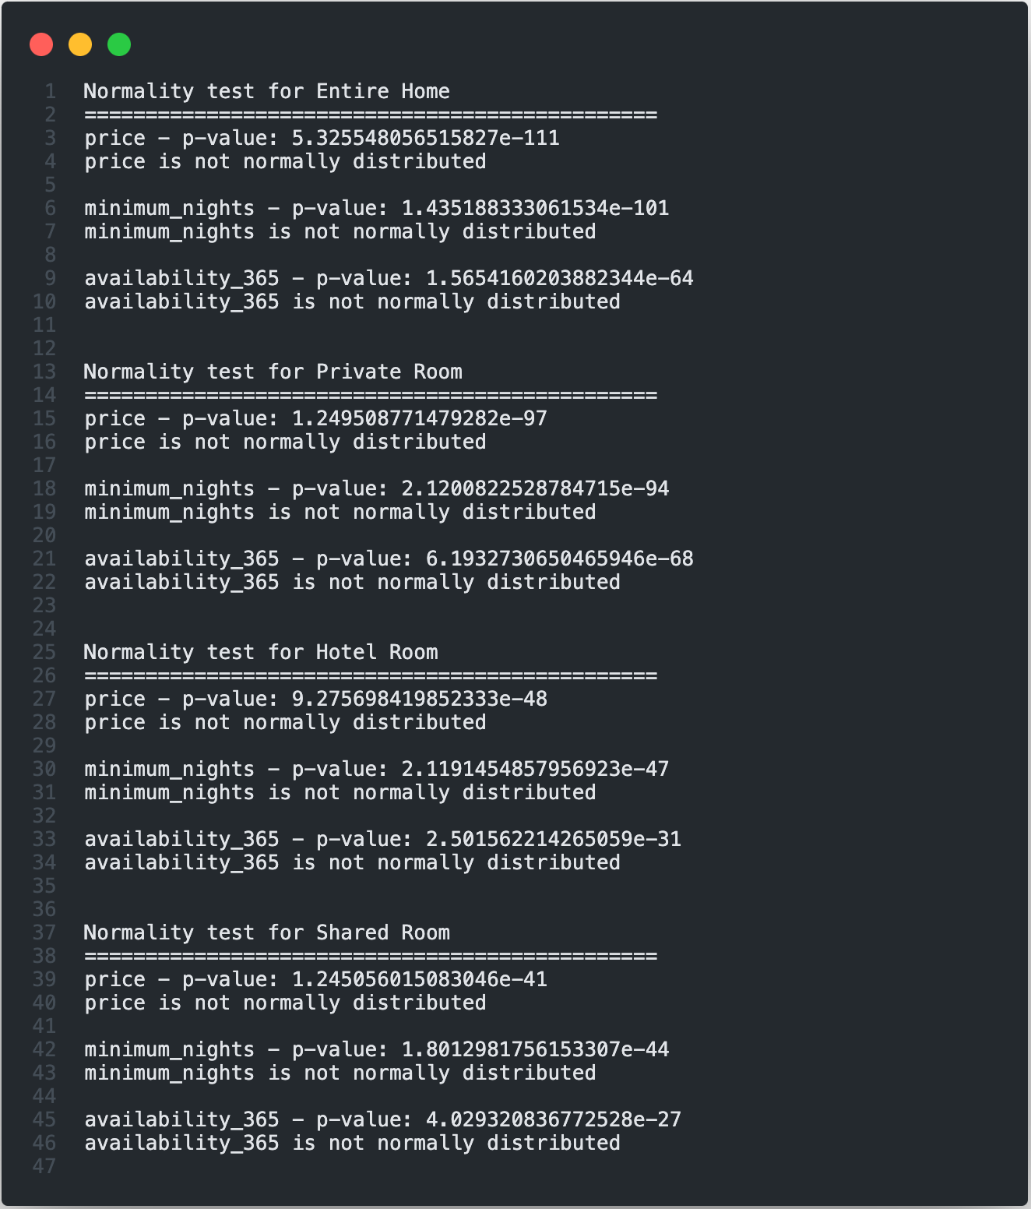

Slide 24
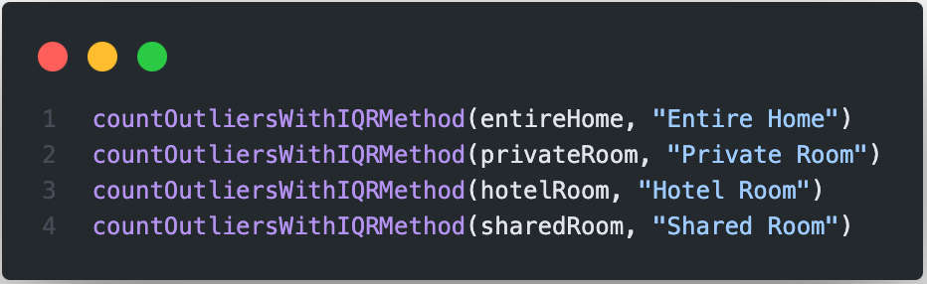
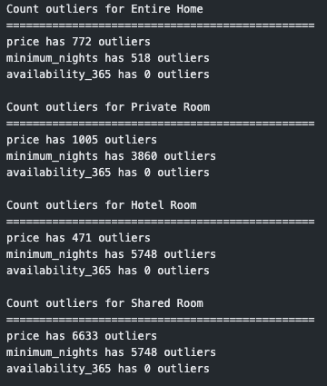

Slide 25
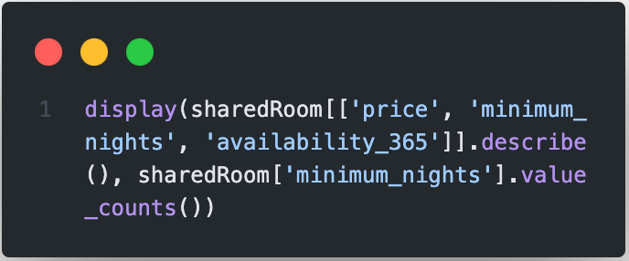
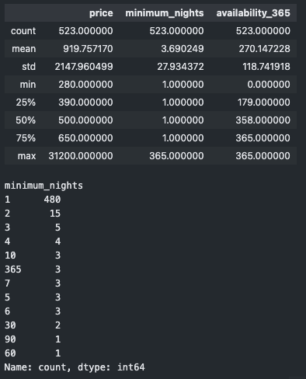
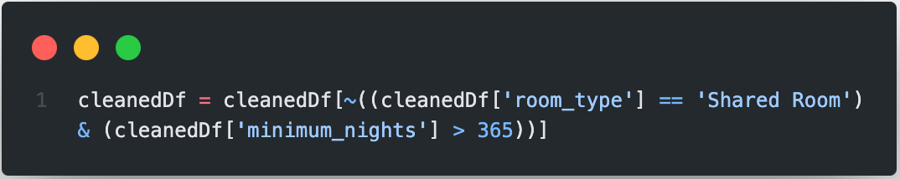

Slide 26
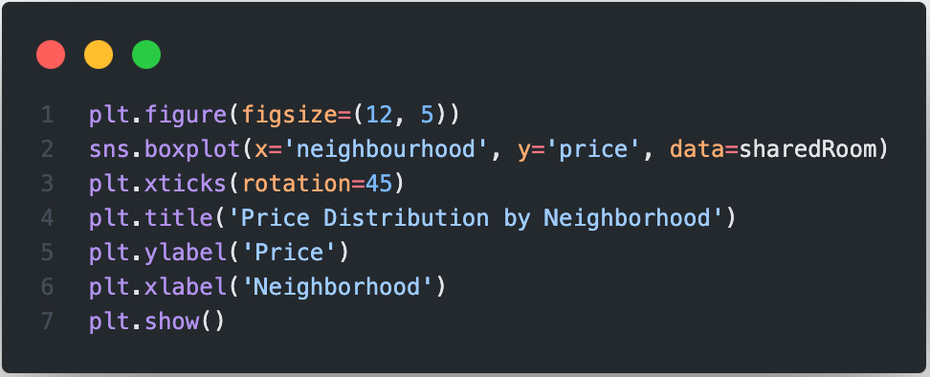

Slide 27
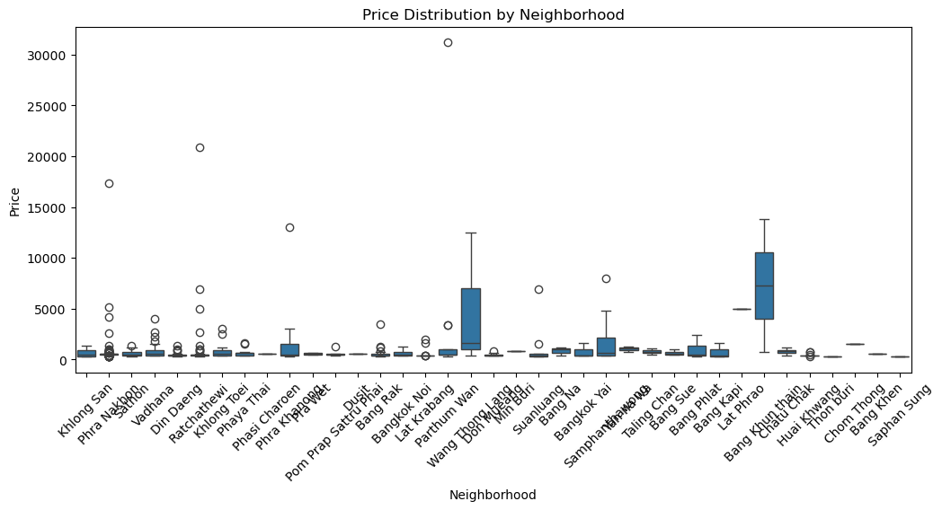

Slide 28
05
Data Analysis

Slide 29
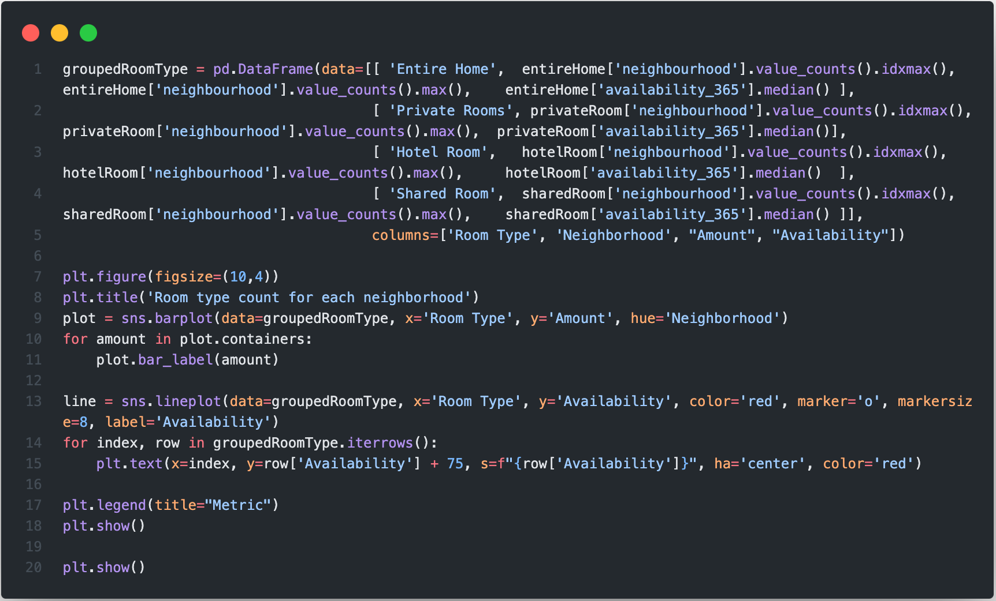
Customer’s Behavior
Which neighborhood is the most popular for tourism?

Slide 30
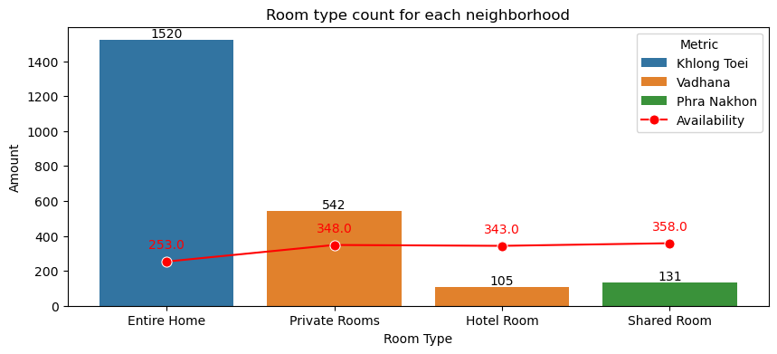
Customer’s Behavior
Which neighborhood is the most popular for tourism?

Slide 31
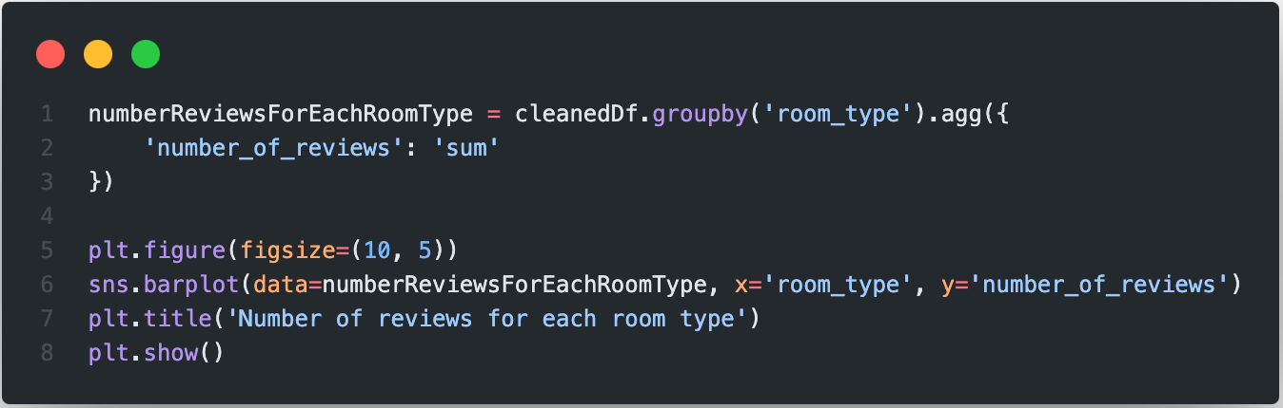
Customer’s Behavior
What is the behavior of customers when leaving a review?

Slide 32
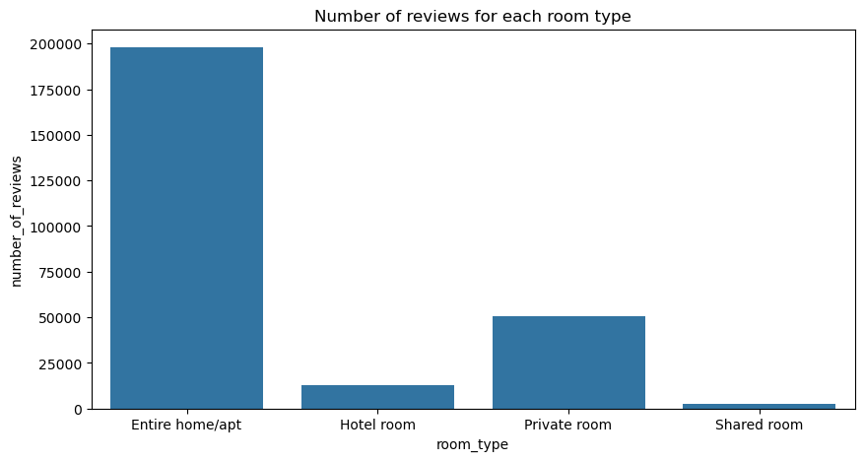
Customer’s Behavior
What is the behavior of customers when leaving a review?

Slide 33
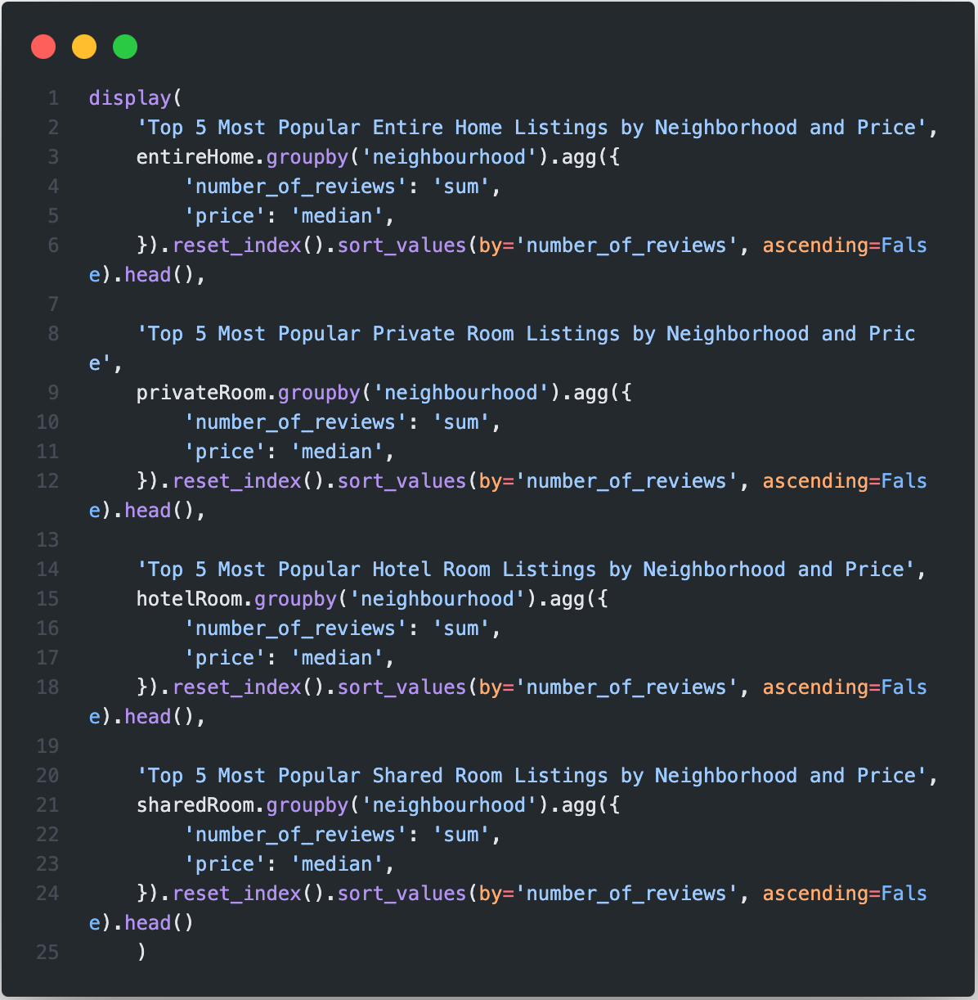
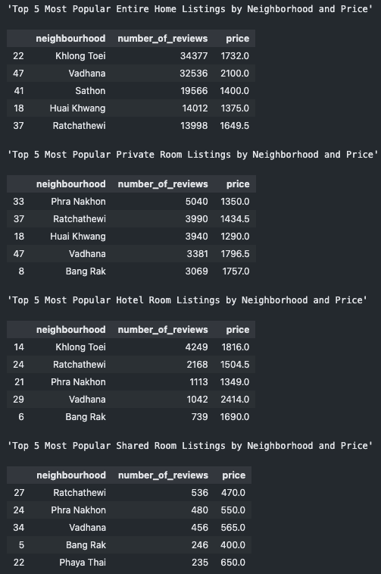
Customer’s Behavior
What is the behavior of customers when leaving a review?

Slide 34
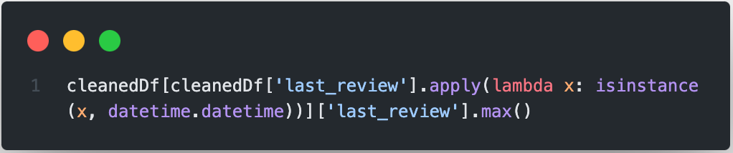
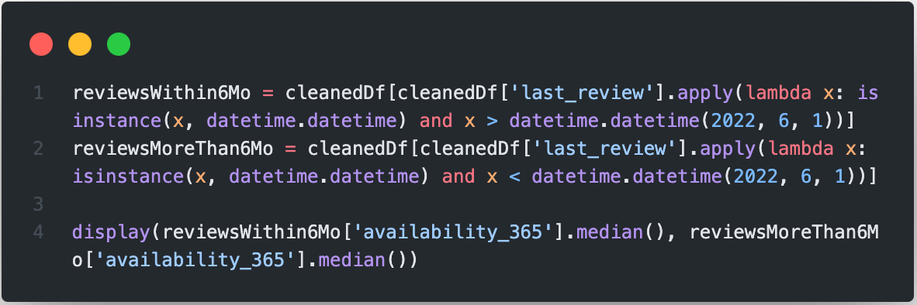
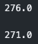
Customer’s Behavior
Are recent reviews important for customer when deciding to choose a room?

Slide 35
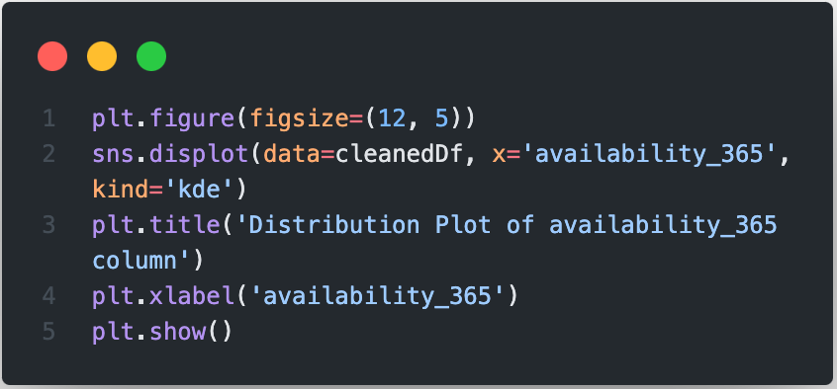

Customer’s Behavior
Are recent reviews important for customer when deciding to choose a room?

Slide 36

Room Owners’s Behavior
Is there any relationship between the number of listing an owner has and the number of reviews they receive per listing?

Slide 37

Room Owners’s Behavior
Is there any relationship between the number of listing an owner has and the number of reviews they receive per listing?

Slide 38

Room Owners’s Behavior
Is there any relationship between the number of listing an owner has and the number of reviews they receive per listing?

Slide 39

Room Owners’s Behavior
Is there any relationship between the number of listing an owner has and the number of reviews they receive per listing?

Slide 40

Room Owners’s Behavior
How does the review count impact the probability of a room being booked?

Slide 41

Room Owners’s Behavior
How does the review count impact the probability of a room being booked?

Slide 42

Room Owners’s Behavior
How does the review count impact the probability of a room being booked?

Slide 43

Room Owners’s Behavior
How does the review count impact the probability of a room being booked?

Slide 44

Room Owners’s Behavior
Do room owners with more frequent reviews offer more competitive price compared to those with fewer reviews

Slide 45

Room Owners’s Behavior
Do room owners with more frequent reviews offer more competitive price compared to those with fewer reviews

Slide 46
Room Owners’s Behavior
Do room owners with more frequent reviews offer more competitive price compared to those with fewer reviews

Slide 47
06
Conclusion and Recommendation

Slide 48
Conclusion
01
02
The room type of Entire home/apt receives most reviews compared to other room type, located in the Khlong Toei which is most popular neighborhood for residential stays.
Number of reviews that any room has impacted the probability of its being booked, while the review date does not.

Slide 49
Recommendation
01
02
Increasing the number of reviews for each room type can lead to more bookings, which in turn increases website traffic.
The low number of reviews for hotel rooms could negatively impact future business, as hotels are popular with tourists who may rely heavily on reviews when choosing accommodations.
03
04
Offering a voucher for the next booking after a review is left could be a good strategy to increase review counts and encourage repeat bookings.
Encourage room owners with small number of reviews to adjust their listings especially on the room type since Shared room and Hotel room are popular for tourists, but Hotel room has higher booking rate. So room owner with Shared room could upgrade their room type to Hotel room.

